Slide 1
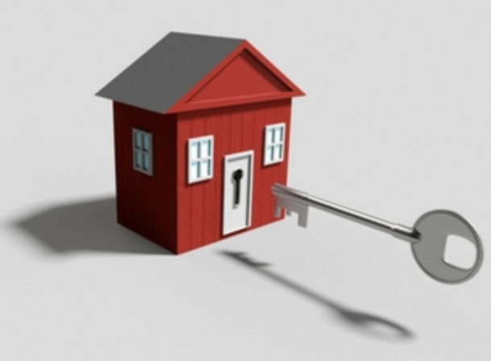
Executive Summary
Small company home investment group
Reviewing real-estate opportunities in Home sales
Looking into market areas that provide investment opportunities to refurbish homes for resale

Slide 2
Data Modeling

Slide 3
81 Unique variables
1460 Data points of consideration
696 homes identified as remodeled
Data Modeling parameters

Slide 4
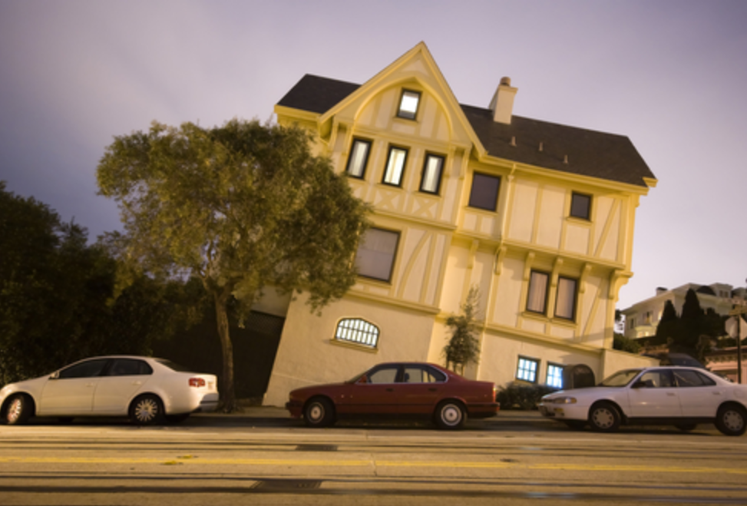
Risk Assumption’s to Business
Undetected property issues
Potential model variation
Changes in market conditions
Lack of current data
Potential pricing index inaccuracies

Slide 5
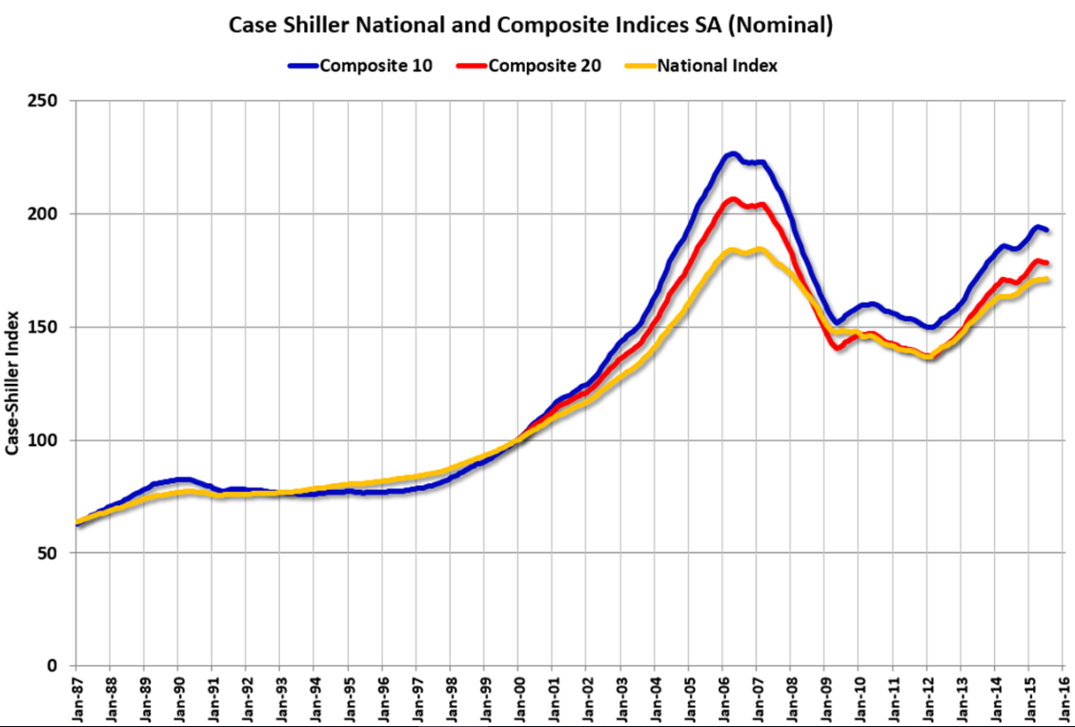
Pricing Index and Normalization
Case-Shiller U.S. National Home Price Index
What is it?
Composite home indices for all nine U.S. Census divisons
Calculated monthly
Normalized to have value of 100 in January 2000
Why we used it?
To normalize sales prices over period of time (2006-2010)
Eliminate economic and market conditions that affect pricing

Slide 6

Model Tuning

Slide 7
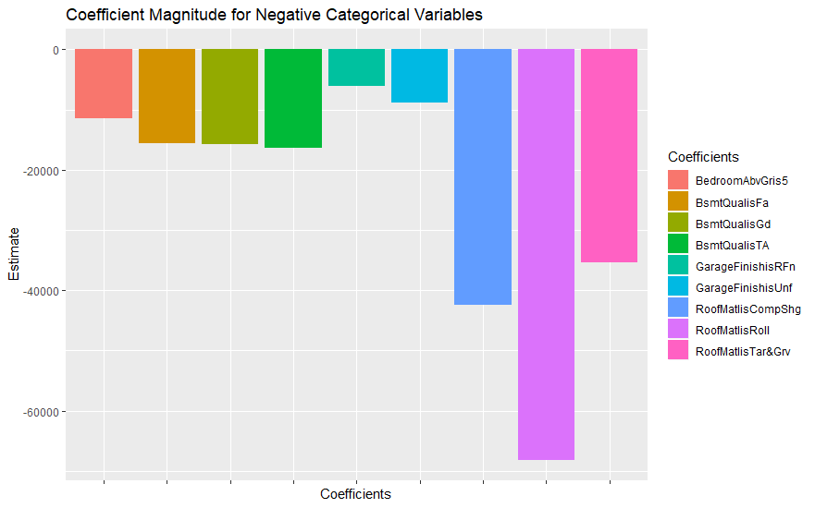
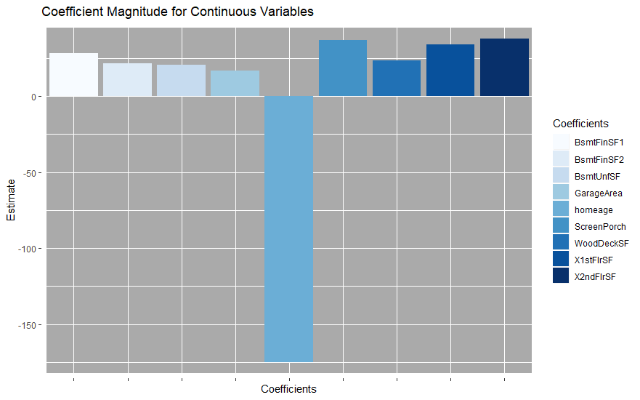
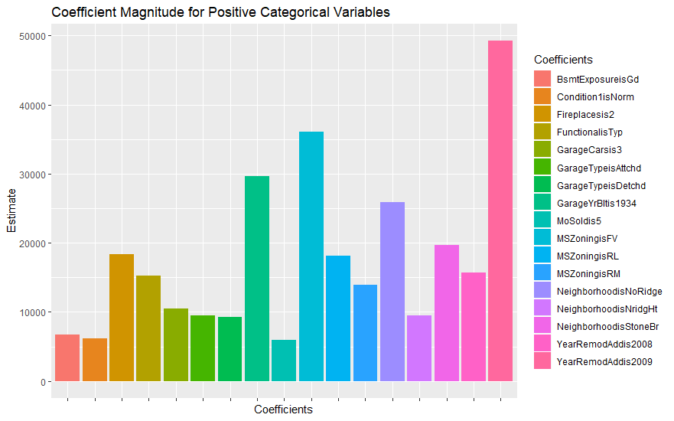
Model Review
Final model based on Remodeled homes consisted of 35 variables
9 continuous variables
26 dummy variables constructed from 15 categorical variables
Initial model attempts used data that was split between continuous and categorical.
Variables with a p-value > .1 were removed
We then combined the two groups and tuned the model accordingly
Finally, we split the data into never Remodeled and has been remodeled.
We created the final model with the homes that have been remodeled and used that to predict the prices of the homes that have never been remodeled.
Our final model had an RSE of $17870. With an Adjusted R-Squared of .8609

Slide 8
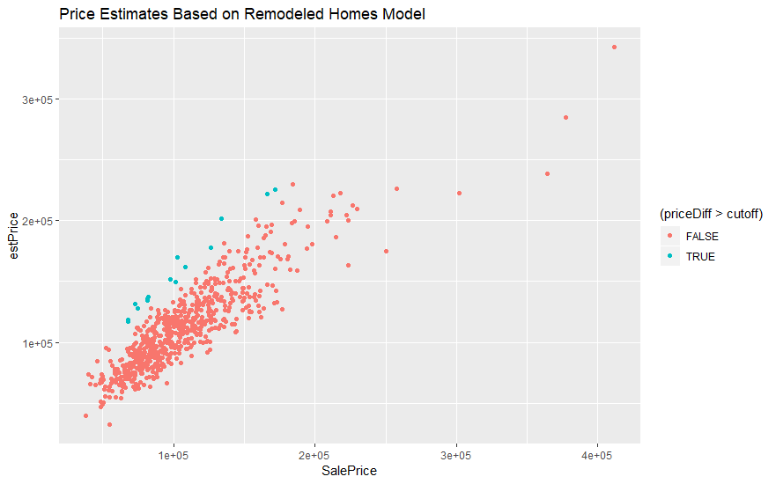
Predictions vs Results
Cutoff based on inflation adjusted average remodel price.(Adjusted to 2000)
Inflation estimator from: https://westegg.com/inflation/infl.cgi
Average Remodel Pricing from: HomeAdvisor.com
Data with estimate higher than Sale on average which is to be expected due to model construction
Some outliers that are well negative

Slide 9
Statistical fitness

Slide 10
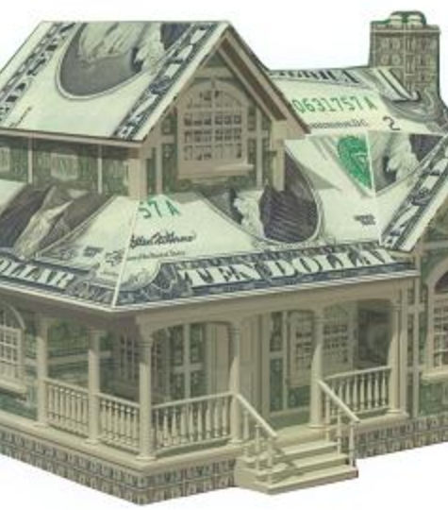
Findings and Conclusions
Target properties

Slide 11
Conclusion

